Slide 1


Information Meeting

Slide 2
Purpose
To give you – a proposed member – an overview of Rotary.
To let you know what your may expect of your membership.
To let you know what our club will expect of you as a member.
To answer any questions that you might have about Rotary in general and our club in particular.

Slide 3
How You Were Chosen to Become a Member of Rotary?
A member of our Club sponsored your membership.
Our Membership Committee verified your personal reputation both in your business and in the community.
Our Board of Directors approved your application.
Our entire membership approved you.

Slide 4
Rotary An International Organization
The Rotary world is divided into groups of clubs. These territories are known as Rotary Districts.
There are 530 districts in more than 200 countries and geographic territories.
Our club is in District 5280 which is composed of 66 clubs with a total membership of over 2500.
Rotary International is governed by a President and a Board of Directors. Annually, each district elects a District Governor. Each Club elects a President and a Board of Directors.

Slide 5

Rotary An International Organization
Rotary was organized in Chicago in 1905 by Paul P. Harris. It was called Rotary because meetings were in rotation at various places of business.
    Originally organized to generate business leads.
    The first service project was in 1907 with the installation of public toilets in Chicago.
There are more than 33,000 Rotary Clubs with a membership of over 1.2 million men and women.
Rotary Clubs receive support from Rotary International, but all activities are started at the Club level.

Slide 6
Object of Rotary
The object of Rotary is to encourage and foster the ideal of service, a basis of worthy enterprise and, in particular, to encourage and foster:
First. The development of acquaintances as an opportunity for service.
Second. High ethical standards in business and professions; the recognition of the worthiness of all useful occupations; and the dignifying of each Rotarian’s occupation as an opportunity to serve society.
Third. The application of the ideal of service by every Rotarian to personal, business, and community life.
Fourth. The advancement of international understanding, goodwill, and peace through a world of fellowship of business and professional persons united in the ideal of service.

Slide 7
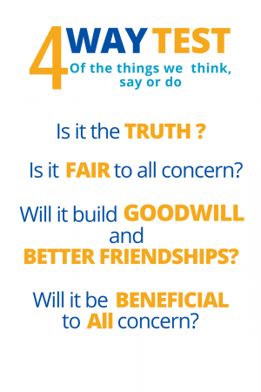

Slide 8

Rotary International is dedicated to 7 areas of focus

Slide 9
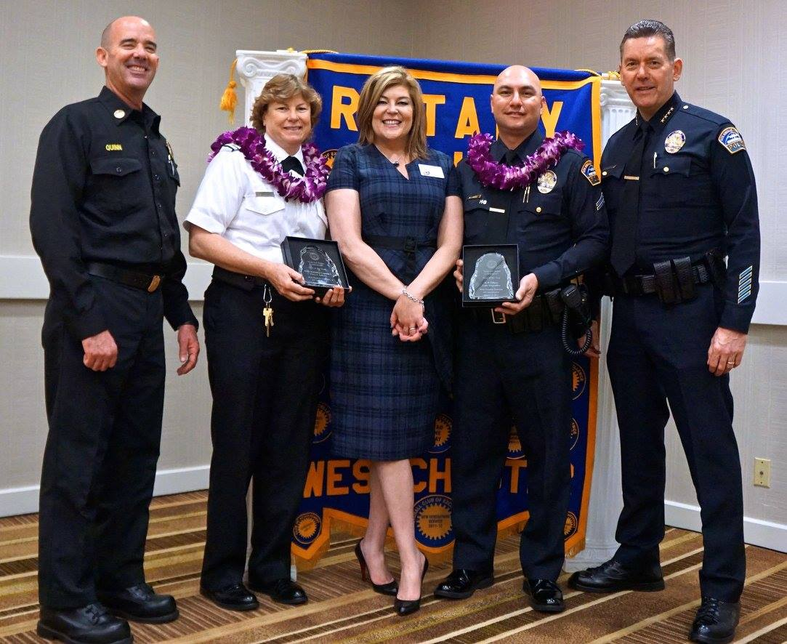
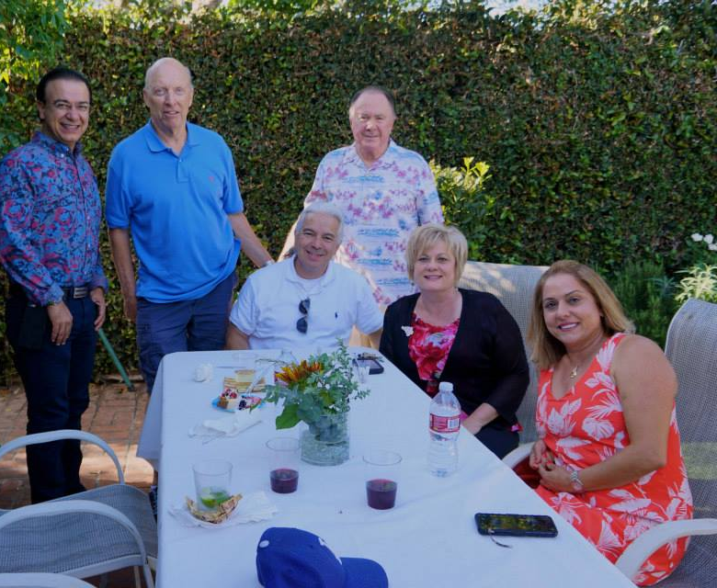
The Avenues of Service
Club Service – Those activities that make a successful Rotary Club. Rotarians serve on committees, propose individuals for membership and meet attendance requirements.
Vocational Service – Representing their professions, Rotarians promote vocational awareness and high ethical standards in business.

Slide 10
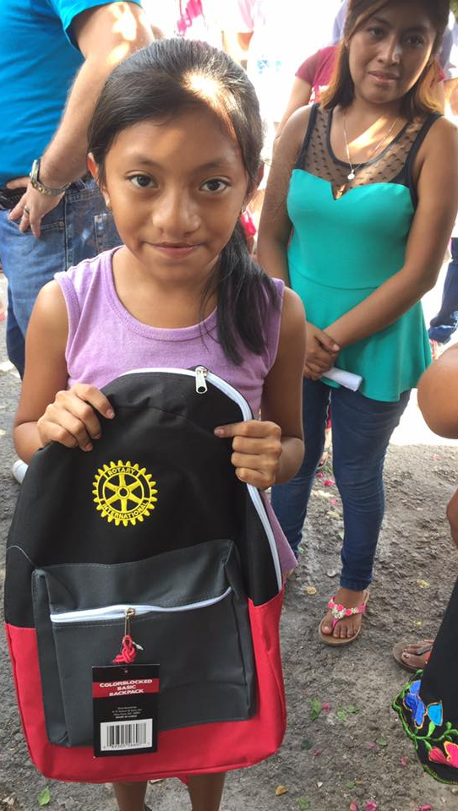
The Avenues of Service
Community Service – Urges every Rotarian to participate in all activities that make communities a better place in which to live.
International Service – Encourages and fosters the advancement of understanding, goodwill and peace. Rotary supports concerted humanitarian efforts throughout the world.
Youth Service – Refers to the youngest generation in the family of Rotary. Many are participants in Rotary’s youth and young adult programs: Interact, Rotaract, Rotary Youth Leadership Awards (RYLA), and Rotary Youth Exchange. Others are service minded young people involved in Rotary club and district activities.

Slide 11
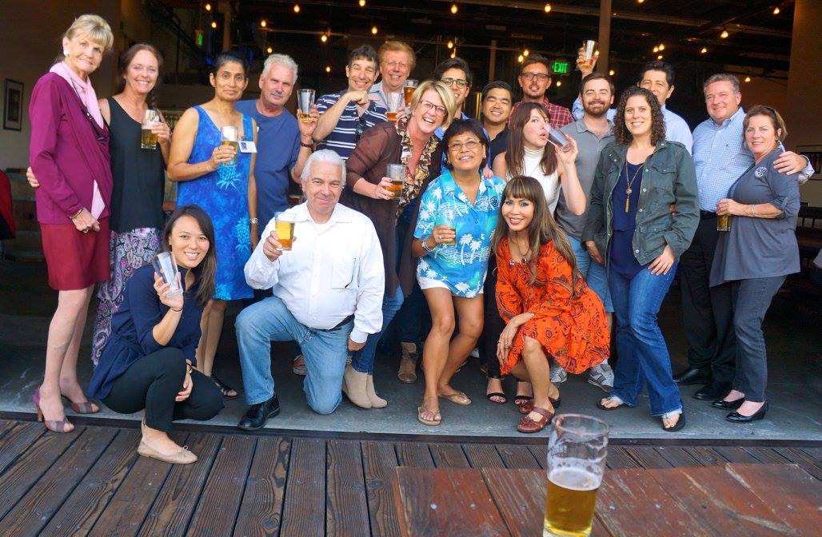
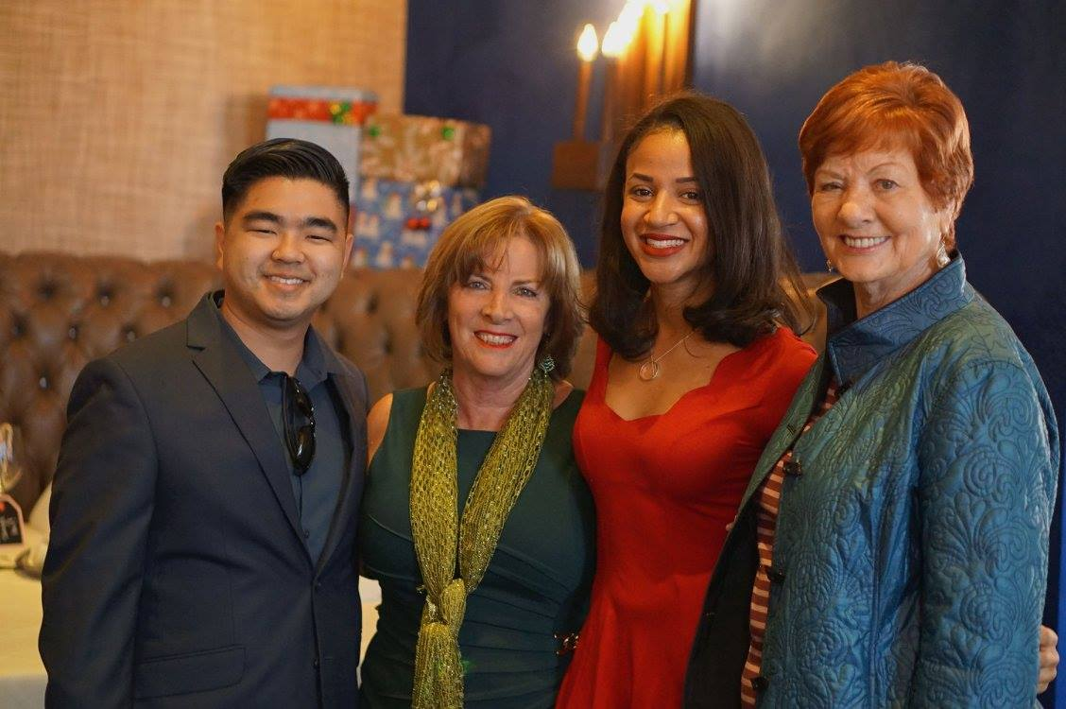
And We Have a LOT of Fun!
Holiday Party
Socials
Joint Meetings
District Conference
Demotion Party

Slide 12
The Rotary Foundation
The Rotary Foundation, established in 1917, has programs and activities that provide promotional, technical and financial support to international service projects around the world.
  Rotary Scholars
  Vocational Training Teams
  Humanitarian Grants
These and many other programs are supported by contributions.
  Paul Harris Fellow
    Donation of $1,000 to the Annual Programs Fund, PolioPlus, or the Humanitarian Grants Program
      $500 for new members
  Benefactor
    Making the Permanent Fund a beneficiary in your estate plans or by donating $1,000+ to the fund outright.
  Bequest Society
    Putting Rotary in your living will or trust.

Slide 13
Your Obligations in Rotary
Participation
To be a Rotarian you must give of your time and talents
In community work
In social functions
In Club and District activities
Attendance
100% attendance is urged and honored in Rotary by
Attending at your club
Making up at another Rotary Club ± 14 days of our club (this includes e-Rotary meetings on-line)
Attending a District Institute, Assembly or Conference or a Rotary International Convention.

Slide 14
Your Financial Commitments
CLUB DUES QUARTERLY: $227
Rotary International Dues (includes $12 Rotary Magazine subscription) | $95.50
District Dues | $82
Club Demotion Party | $100
Spring Fundraiser | $100
Club Expenses | $530.50
Total Annually | $908
Lunches - Quarterly: $180 (OPT IN)

Slide 15
Rotary Publications
Rotary International publishes The Rotarian
You will receive this magazine each month.
It contains news and activities of Rotary around the world and other interesting articles.
Our club will also provide you
A directory of the club members.
Access to our website (http://www.rotary-westchester.com/) which contains up-to-date information about our Club’s activities.
Friend our Facebook site (Westchester Rotary) for information about upcoming events and meetings.

Slide 16
The Best Way to Get Started in Rotary
Become active in Club meetings and social activities
Volunteer for projects
Become active on a committee
Visit other Rotary Clubs when you travel or miss a meeting
Attend and participate in District Events
Invite friends and business associates to join Rotary

Slide 17
Rotary Club of Westchester
Our Club’s Past/Recent Service Projects
Extreme Home Makeover (every other year)
Human Trafficking Prevention Initiatives
Safe Place for Youth (S.P.Y.)
Habitat for Humanity
1736 (Shelter for Abused Women and Children)
New Zealand Student Visit
Our Club’s Major Fundraisers
Book Sale (69+ years and counting)
Spring Fundraiser

Slide 18
Our Club’s Leadership
Officers
Edgar Saenz (President of Record)
Tori Szabadi (Co-President)
Tom Johnstone (Co-President)
Val Velasco (Co-President)
Stephanie Davis (Secretary)
Heather Martillo(Treasurer)
Eric Medrano (Immediate Past President)
Karen Waldenmayer (Sgt. at Arms)
Directors
Cindy Williams (Club Service)
Sherrill Pentis (Community Service)
TBD (Foundation)
Edgar Saenz (International Service)
Nicole King (Vocational Service)
Greg Goldfarb (Youth Service)
Cindy Williams (Membership)

Slide 19
Westchester Rotary Foundation
We are able to support club projects through the
Westchester Rotary Foundation. These include:
  Community Club Fundraisers: Individual Contributions
  Partner Annual Book Sale
  Contributions Spring Fundraiser

Slide 20
Foundation Board of Trustees
Voting members
Ex-Officio
Darlene Fukuji (Chair)
Judy Delavigne (Vice Chair)
Christa Haggai Ramey (Secretary)
Brett Sifling (Treasurer)
Renate Hild (Trustee)
Fred Puza (Trustee)
Eric Medrano (Immediate Past
  President)
Tom Johnstone (Club Co-President)
Richard Moon (Accountant)
Michael Laine (Financial Advisor)
Stephanie Ulchick President Rotary International
Albert Hernandez, District Governor

Slide 21
BEYOND THE CLUB
There are opportunities for additional funding through matching funds through the District and rotary International. These include:
(Reverse) Global Grants
Human Trafficking initiative in South Korea
District Grants
  Operation Easter – School supplies and Easter Party for kids and families.

Slide 22
Welcome to Rotary
Remember, no organization is greater than its individual members.
YOU ARE ROTARY
  Participate for Friendship
  Participate for Service
  Participate for Fellowship
  Participate for Knowledge
  Participate for International Understanding

Slide 23
Rotary Club of Westchester
Westchester Rotary Foundation
P.O. Box 91543
LA, CA 90009
http://www.rotary-westchester.com/
Westchester.rotary@gmail.com
©Westchester Rotary Foundation
Duplication of materials prohibited without written consent of Westchester Rotary Foundation

